Slide 1
Implementing the Blended Learning Station Rotation Model
Notes:
1 min.
Facilitator Note: So again, welcome to today's session, which is entitled Implementing the Blended Learning Station Rotation Model. I am your facilitator for today. My name is ______.
Do: Allow participants to sign-in if required by building admin. When it is time for the session to start, state the title and introduce yourself and allow moderator/co-presenter introduce themselves as well.

Slide 2
Vision for Student Success
Every day, Memphis Shelby County School students experience high level
of success with challenging content in our classrooms and show consistent academic growth and achievement each year. We are committed to preparing well-rounded graduates who compete globally, because they persevere through challenges, think critically, advocate for and drive their own learning experiences, and collaborate effectively with diverse peers.
Notes:
Time: 1 min.
Facilitator Notes:
Paraphrase the Vision for Student Success.
You may choose to have participants read and/or call out any terms or phrases that resonate with them.

Slide 3
Reimagining 901
The Reimagining 901 plan is about truly transforming the educational experience for students in every school community in this District.
Notes:
Time: 30 Seconds
Facilitator Notes: Implementing blended learning is one of the innovative approaches to learning that supports our Reimagining 901 plan.

Slide 4
Session Outcomes
Overview:
Blended learning provides students with an opportunity to engage with the standard in high quality tasks while addressing individual academic gaps.
Outcomes
As a result of this session, participants will be able to effectively plan and implement standards-aligned lessons using the station rotation model.
Notes:
Allow participants to read the Overview and Outcomes silently.
Say: As you can see, by the end of this session...
READ the “Outcomes”

Slide 5
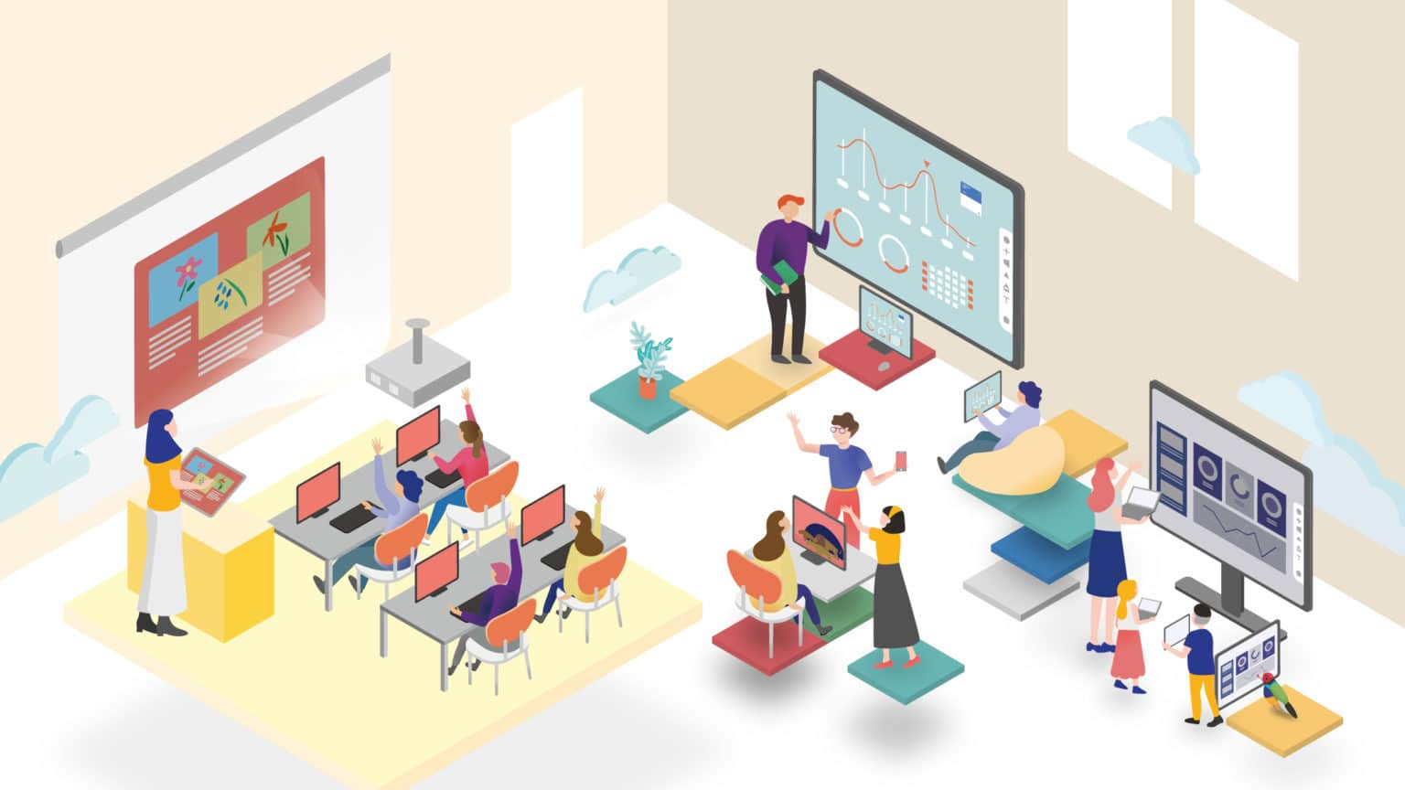
Why Blended Learning?
Conducive to the way students learn today
Prepares students for college and career
Increases engagement
Improves efficiency and feedback opportunities
Promotes student ownership of learning
Notes:
Time: 1 min.
Say:
Let’s talk about the “Why” behind blended learning. First, we know, based on research, it is conducive to the way students learn. It also prepares students for college and career readiness. It does that through increasing student engagement, improving efficiency and feedback opportunities, and finally by promoting student ownership of learning.

Slide 6
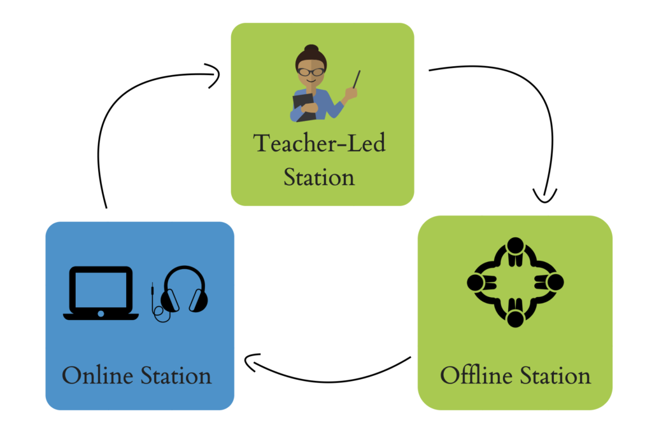
Station Rotation Model
The station rotation model is executed during Tier 1 instruction to support the delivery of the MSCS curriculum.
Teachers begin by planning a curricular lesson based on the goal or overall outcome of the lesson.
After the instructional lesson has been planned, the teacher then determines which components of the lesson will be executed in a teacher-led station, online station, and offline station.
Notes:
Time: 1 Minute
Say: The Station Rotation model should be executed during tier 1 instruction using the MSCS curriculum. After planning, teachers will determine which parts of the lesson lends themselves to the implementation of blended learning in three distinct stations: teacher-led, online, and offline stations.

Slide 8
MSCS Technology
Moving from Intervention to
Innovation
What do we know?
Challenges exist with care of student devices
How will we support schools?
Limited inventory has been received. Students who have satisfied replacement fees and those new to schools will begin receiving devices immediately.
Replacement devices are coming soon (April)! All students registered for the 2022-23 SY will be receiving devices immediately.
Digital Device Ambassadors & Digital Learning Ambassadors should work together to develop a device check-out process. IT will update laptops to be used in-school loaners.
Padded carrying cases/backpacks will be purchased for primary grade students.
Focus on the 80%
Notes:
Time: 1 minute
Say:​
We are moving from intervention to innovation by focusing on the 80% of students that do have access to devices. This was determined during the recent Power-up Week where all MSCS students brought devices to schools for an evaluation of the device's working status.

Slide 9
Blended learning increases student engagement and promotes student ownership
Teachers and school leaders have engaged in blended learning training from Engage2Learn, Virtual Education and Logistics, C&I, and PL&S
Key Ideas
Notes:
Time: 1 minute
Say: Now let's recap this section. Some of our key ideas include: blended learning increases student engagement and promotes that student ownership of the learning and teachers and school leaders have received blended learning training from E2L, EdTech, C&I, and PL & S.

Slide 10
Pause and Reflect
How are you currently with utilizing technology in your classroom? How can you build on those foundations to implement the station rotation model?
Notes:
Time: 2 minutes​
Say: Take about a minute to answer the Pause and Reflect question on the slide​. Participants can do a turn and talk, jot down an answer on a post it, or any other engagement strategy that is appropriate to your setting.
​
Facilitator Note: Allow two to three volunteers to share their answers

Slide 11
Model Lesson
Video
Notes:
Time: 15 seconds
Say:
Now let's reflect on the teacher moves we observed in the video

Slide 12
Elementary Math Blended Learning Model Lesson
Notes:
Facilitator notes: Please play the video and watch the highlights from the model lesson. You will debrief the lesson and look at the planning process in the next section. For your reference, the debrief questions will be
What teacher moves supported the execution of the station rotation model?
Where did you see the components of a standards-aligned lesson and the Direct Teaching Model?

Slide 13
Model Lesson
Reflection
Notes:
Time: 15 seconds
Say:
Now let's reflect on the teacher moves we observed in the video

Slide 14
Reflecting: The Model Lesson
Let's reflect on the lesson
What teacher moves supported the execution of the station rotation model?
Where did you see the components of a standards-aligned lesson and the Direct Teaching Model?
Notes:
Time: 5 minutes
Say: Now, let's debrief the lesson we just saw on the video by answering two questions:
First, What teacher moves supported the execution of the station rotation model?
Possible responses include but are not limited to
Included station rotation pathways and descriptions of each station on PPT so students knew what was next
Timers set and visible
Aggressive monitoring, actively monitoring student progress and giving feedback in real time during student work time
In a real class setting, the teacher would use the data from her aggressive monitoring to decide which station each student needed to visit first
Using the materials from the curriculum within the station activities
Give participants time to respond then …
Say: Now, where did you see the components of a standards aligned lesson and the DTM?
Possible responses include but are not limited to
Blended learning rotations fit within the gradual release model, in this case the You Do in Pairs and You Do Independently stages were used for station rotations
Standards-aligned lesson tasks from the curriculum can be used in stations, see PLC guides for suggestions
Online curriculum platforms can be used in your stations to support digital engagement with standards-aligned tasks

Slide 15
Planning for Blended Learning Station Rotation
Notes:
Time: 15 seconds
Say:
Let's now talk about planning for blended learning station rotation.

Slide 16
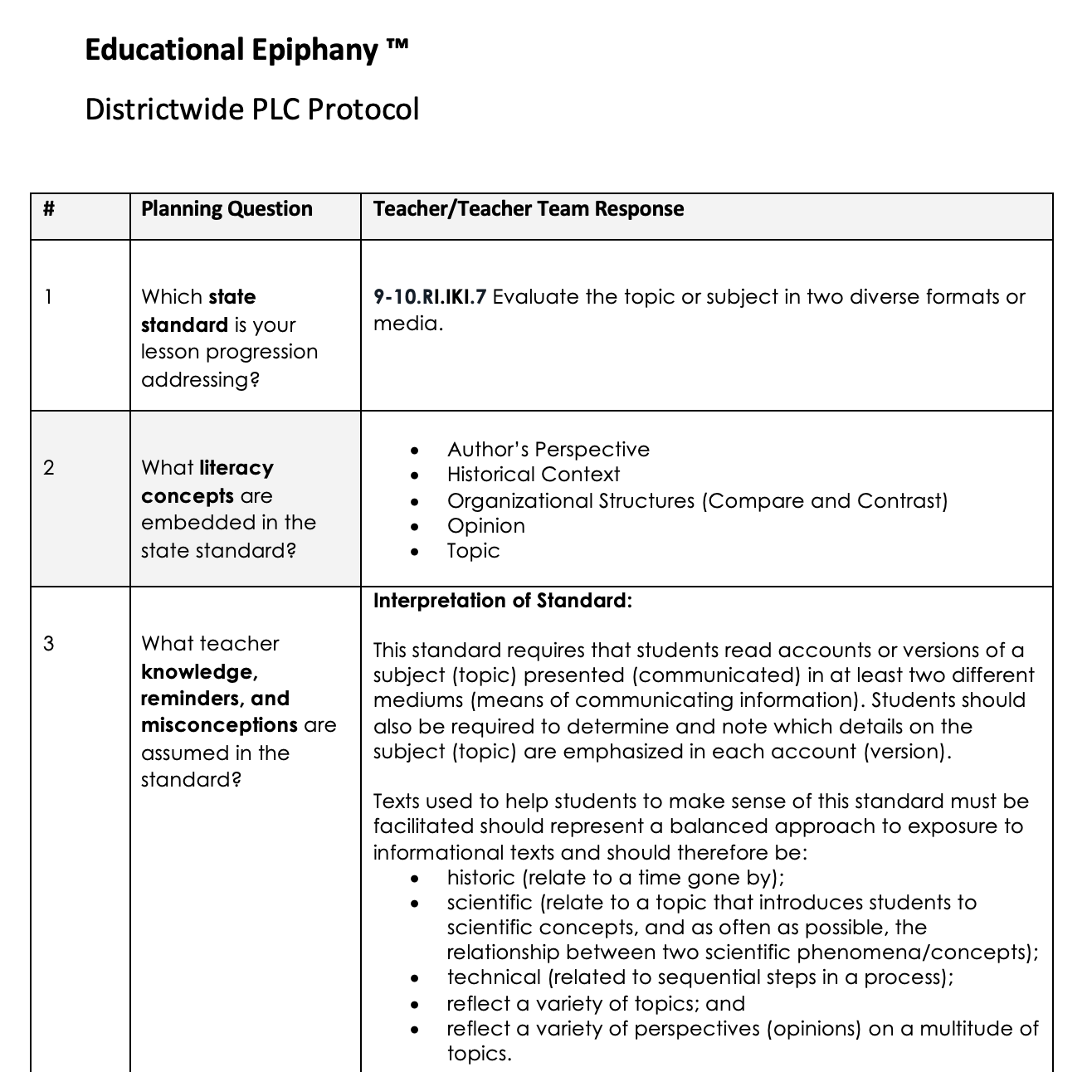
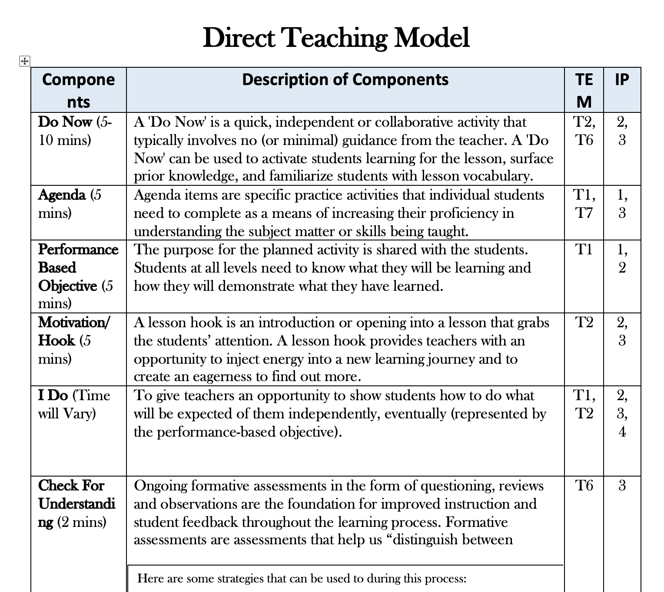
Reflecting: Lesson Planning
Let’s examine the lesson plan and identify where the teacher implemented the stations that were modeled
Notes:
Time: 30 seconds
Do: Provide participants with the lesson planning documents.
Say: At this time, lets take a look at the lesson planning documents from the model lesson. Let's review the PLC Protocol and DTM documents and determine where the techer implemented the stations.

Slide 17
A Process for Supporting Standards-Aligned Lesson Planning with the Station Rotation Model
Let’s examine the lesson plan and identify where the teacher implemented the stations that were modeled
Step 1: Complete PLC Planning Protocol
Internalize the standard, PBO, and lesson materials
Utilize district curricular resources
Step 2: Determine stations based on GRR/5E Instructional Model
Use PLC Planning Protocol recommendations, planned GRR/5E questions, tasks, or problems
Step 3: Align lesson content to the DTM
Resources: Re-Teach Calendar, IP3 CFU Toolkit
Step 4: Align resources and lesson materials needed to execute the lesson
Notes:
Time: 1 minute
Say: Next, lets review the process for supporting lesson planning with the station rotation model. There are four steps which start with completing the PLC protocol for your content area, then determine the stations and where in the GRR/5E model those stations should be implemented, next, align your lesson to the Direct Teaching Model, and finally utilize lesson materials and resources to execute the lesson. These steps are universal to any content area or grade level.

Slide 18
Reflecting: The Planning Process
Let's reflect on the lesson planning
What planning moves were different to plan for the Station Rotation lesson?
How does the Station Rotation lesson align to the PLC Planning protocol and the DTM?
Notes:
Time: 5 minutes
Say: Thinking about the process and over the provided lesson planning documents, let's talk about these two questions.

Slide 19
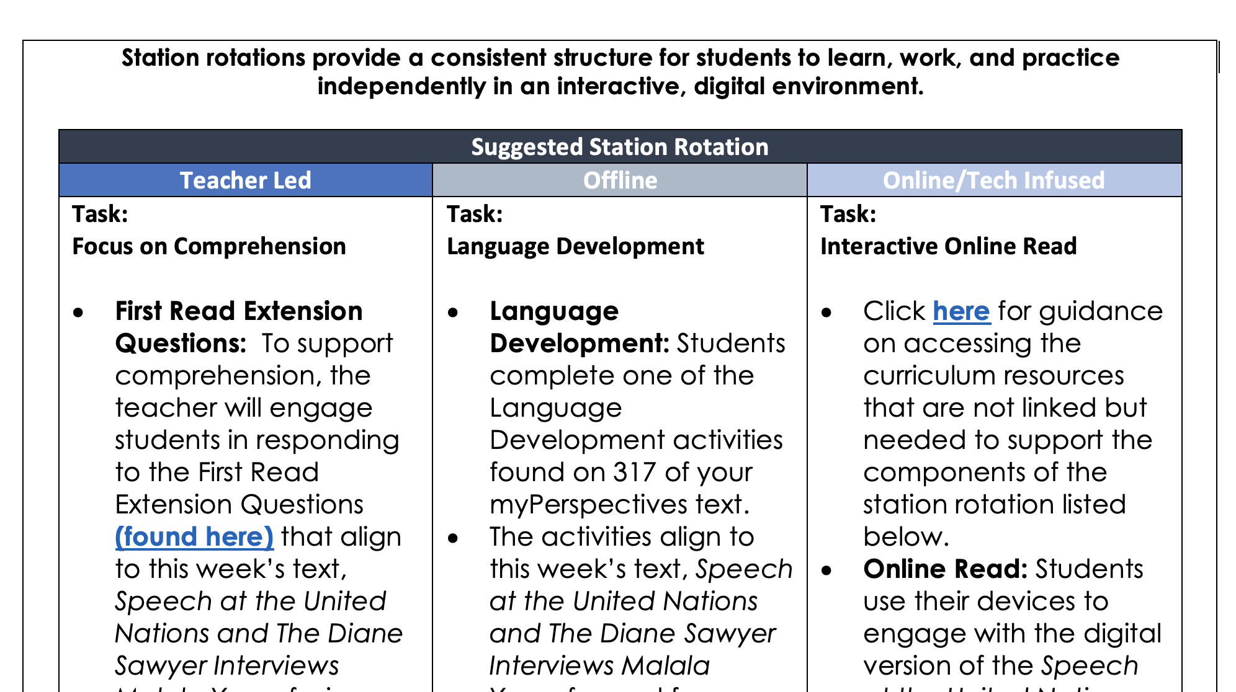
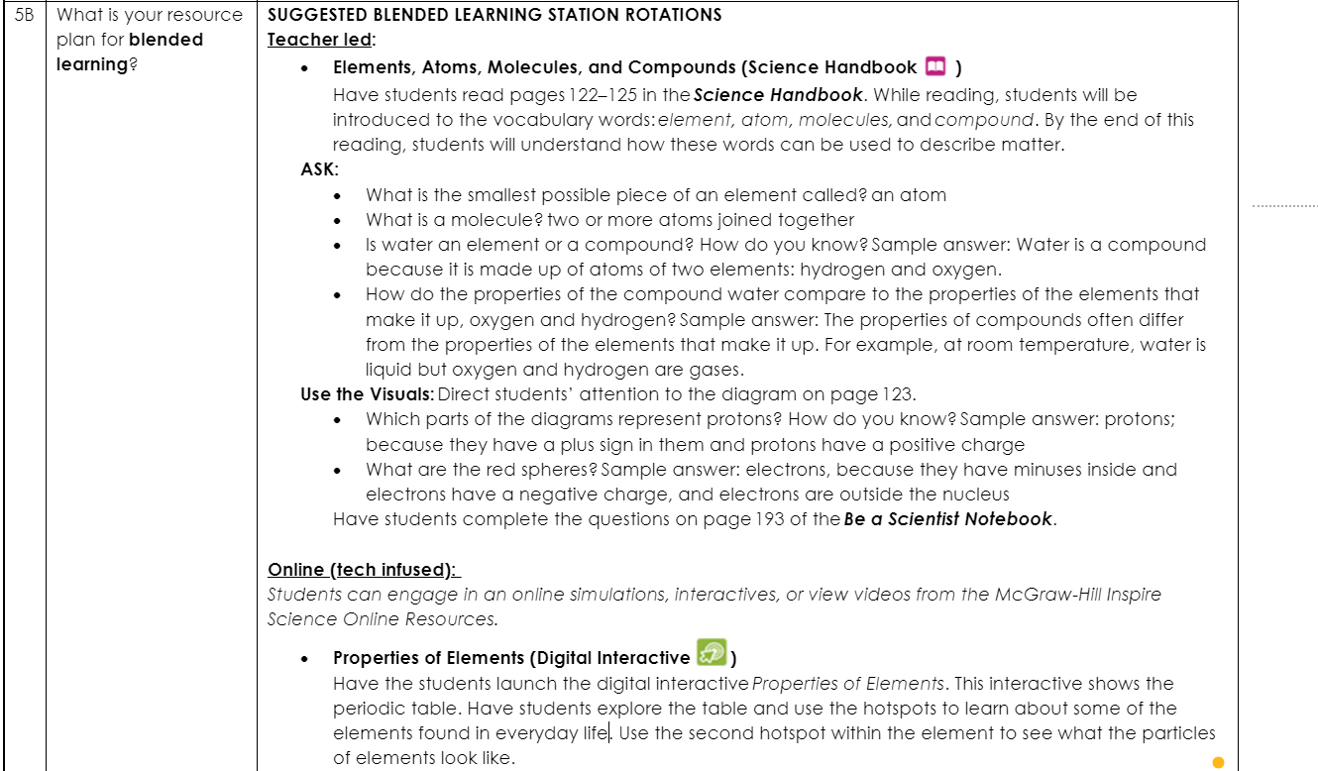
Planning for Station Rotation
Additionally, C&I has included recommendations in the Q4 PLC Protocols.
Notes:
Time: 30 seconds
Say: In the quarter four PLC protocol documents housed in the Curricular Initiative folder, recommendations for blended learning have been embedded. The first image is from an ELA protocol document, the second image is from Science which is question 5B (that’s new question), and the last image is from a Math PLC protocol document.

Slide 20
Planning for Station Rotation
ELA resources: Wonders activities for collab, Clever apps for tech, Brain-pop for tech, Ready reading for Teacher lead, TCAP for collab
Math resources: Greatminds for tech, clever apps for tech, Iready resources for collab, TCAP for collab
Notes:
Time: 30 seconds
Say: In the quarter four PLC protocol documents housed in the Curricular Initiative folder, recommendations for blended learning have been embedded. The first image is from an ELA protocol document, the second image is from Science which is question 5B (that’s new question), and the last image is from a Math PLC protocol document.

Slide 21
A Process for Supporting Standards-Aligned Lesson Planning with the Station Rotation Model
Questions to Consider:
What do you want your students to know?
What do you want your students to be able to do?
How many stations are needed to execute your lesson effectively?
What instructional resources will you leverage for offline and online stations?
What skills do your students need to learn to use these resources independently?
What type of learning will happen at each station (collaborative, individual, teacher facilitated, etc.)?
What routines and procedures do you need to facilitate rotations?
How will you hold students accountable and assess students' progress?
Notes:
Time: 1 minute
Say: When you are planning for the station rotation model, consider the following questions to ensure alignment with the standards. What do students need know and be able to do (this is linked directly with the PBO)? How many stations are needed to execute the lesson effectively? How will you leverage the instructional resources in the offline and online stations? What skills will students need to access these resources independently (for example a step sheet/ instructions to access it)? What are the procedures and routines needed to facilitate the rotations? Lastly, how will how student accountable for the learning and assess their progress?

Slide 22
Systems and Processes
Classroom systems and processes are vital to classroom management and help support you and your learners so everyone can engage in the learning process and have less questions and be more collaborative and productive.
You already have systems and processes for other things in your classroom. How can you leverage these systems to support implementing Blended Learning Station Rotation?
Let’s consider these areas Systems and Processes:
Communication
Rotation
Organization
Transitions
Grouping
Notes:
Time: 2 min.
Say: If you recall, during DLD E2L displayed photos as example of each system and process need for the implementation of the Blended Learning Station Rotation. The areas of consider are communication ( who will let students know what to do and the schedule of the rotation), rotation ( Are the stations moving to them or not), organization (How will you keep the materials accessible to you and students?), transitions ( Will students rotate? How will the process roll out seamlessly?), and grouping ( How will you leverage the data you are collecting during Do Now, We Do, and etc.. to inform the instructional grouping?)

Slide 23
Blended Learning Station Rotation Look-Fors
Station Rotation Model classroom look-fors:
☐ High Student Engagement
☐ Grade Appropriate Material
☐ Standards-aligned Stations
☐ Groupings clearly defined by data
☐ Student Movement/Transition Plan
☐ Online (Technology-based) Station
☐ Peer Collaboration
☐ Effective Time Management
☐ Student Choice
☐ Intervention Station
☐ Teacher Monitoring
☐ Teacher Preparation
☐ Teacher-provided Feedback
☐ Clearly Identified Stations
☐ Integrated Learning
☐ Differentiation for Student Levels
☐ Teacher-Led Station
☐ Offline Station
Notes:
Time: 2 min.
Say: At this point, you probably have some questions. What are the look fors? What do I need to do? Here is a list of look fors during the implementation of the station rotation model. Utilizing grade appropriate materials which means that you are using the district provided curriculum and approved resources, Providing teacher feedback, effectively managing instructional time, allowing students to have choice, monitoring students to justify groupings, intentionally preparing for the teacher-led, offline, intervention, and online station with distinction between the stations, providing opportunities for peer collaboration, and making considerations for student movement/transition, integrated learning, and the differentiated learning levels of all students.

Slide 24
Blended Learning Implementation
April 4th
District-wide Rotation Station Implementation Date
Device Options
1:1 Student Device
Computer Lab Rotation Schedule
5-10 Laptops Per Classroom Station
Notes:
Time: 1 min.
Say: Keep in mind that the district-wide implementation date for blended learning is April 4th. Device options include 1:1 student device ( meaning all of your students have their own device that they can utilize), Computer lab rotation schedule ( which means having students go to the computer lab to engage with the online station opportunities), and 5- 10 laptops per classroom station ( This could have two different looks: students with devices share their with those that don't, or check out computers from the Laptop cart).

Slide 25
The Station Rotation Model allows students to engage deeply with the standards
MSCS has resources available to assist with the implementation of blended learning
After planning the lesson, determine which tasks are online, offline, and teacher-led stations
Key Ideas
Notes:
Time: 1 minute
Say: Now let's recap this section. Some of our key ideas include: planning a station rotation model should include an online, offline, and teacher-led station. This type of lesson allows students to engage deeply with the standards and we know MSCS has the resources available to assist with the implementation of blended learning.

Slide 26
Pause and Reflect
How does this model inform your next steps when planning to implement station rotation in your classroom?
Notes:
Time: 2 minutes
Say: Take about a minute to answer the Pause and Reflect question on the slide in the chat.
Do: Read the question. How does this model inform your next steps when planning to implement station rotation in your classroom? Option 2: Have a participant read the question.
Participants can do a turn and talk, jot down an answer on a post it, or any other engagement strategy that is appropriate to your setting.
​
Facilitator Note: Allow two to three volunteers to share their answers

Slide 27
Session Outcomes
Overview:
Blended learning provides students with an opportunity to engage with the standard in high quality tasks while addressing individual academic gaps.
Outcomes
As a result of this session, participants will be able to effectively plan and implement standards-aligned lessons using the station rotation model.
Notes:
Time: 1 min.
Say: So did we meet our learning outcomes for today as a result of today's sessions, participants will be able to plan standards, aligned lessons using the PLC Planning guide and identify curricular opportunities to implement blended learning station rotations within the direct teaching model.

Slide 28
Bridge to Practice
Plan: Access curriculum resources and PLC protocols to plan standards-aligned station rotation lessons. Choose which components of the lesson to use in teacher-led, online, and offline stations.
Prepare: Engage in deliberate practice with peers to prepare for station rotation lessons.
Do: Engage students in standards-aligned station rotation lessons twice a week.
Notes:
Time: 1 minute
SAY: As we are thinking about the next steps on how to utilize the information gained through engaging in today’s session on Implementing the Blended Learning Station Rotation Model, we are asking that you complete the Bridge to Practice here next week.
Facilitator Note: Ask participants to read the plan, prepare, and do. Option 2, say: As we prepare for next steps, remember to plan by accessing curriculum resources which includes the PLC protocol document to ensure alignment with station rotations with lesson(s). Keep in mind that you must determine when the teacher-led, online, and offline station will occur during the Direct Teaching Model ( For example, We Do, You Do in Pairs, etc..... and for Science which phase of 5E (Engage, Explore, Explain, Elaborate, Evaluate).

Slide 29
Session Reflection
What will be your next steps for implementing station rotations in your classroom?
Notes:
Time: 3 mins
Say: Now let's take a few minutes to reflect on the session and share out on the following question: What will be your next steps for implementing station rotations in your classroom?
Do: Have participants share out

Slide 30
Together, we MUST BELIEVE.
Together, we WILL ACHIEVE.
Together, we are REIMAGINING 901.
Notes:
Time: 30 seconds
Say: It is now time to participate in our District Roar. Please join me.
Do: Begin reciting the roar.
Lead the Roar!

Slide 31
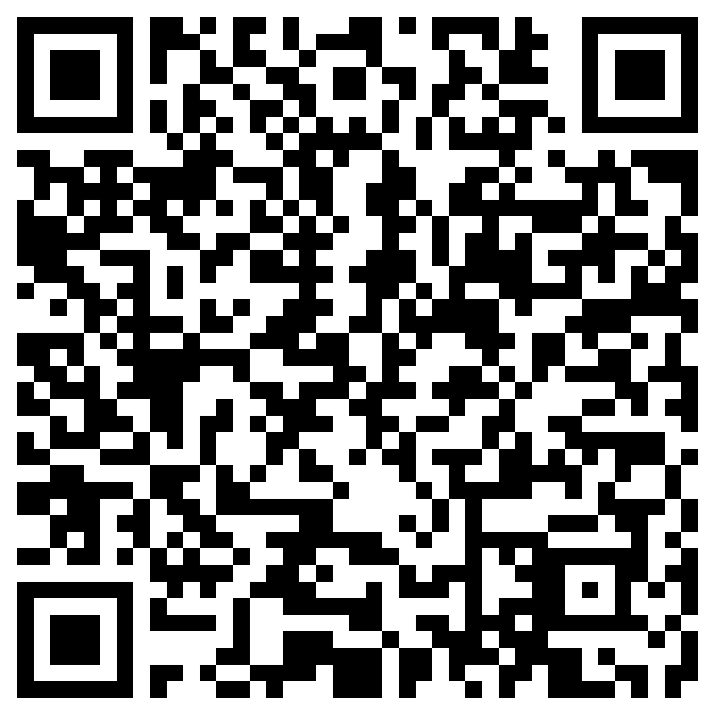
Attendance:
Implementing the Blended Learning Station Rotation Model
Click here or use the QR Code to submit attendance.
Notes:
Time: 30 seconds
Say: It is now time to participate in our District Roar. Please join me.
Do: Begin reciting the roar.
Lead the Roar!

